Slide 1
5.1 The internet and the world wide web
Cookies

Slide 2

What is a cookie?
Typically, a cookie is a small text file with ID tags that is stored on your computer. Cookies are created when you use your browser to visit a website. They are typically used track your movements on the website and can help by:
Resuming where you left off when you revisit the site.
Remembering your registered login.
Remembering theme selections.
Remembering preferences.
Customising your experience in other ways.

Slide 3
What is a cookie?
By law, any website operator using cookies must:
Tell users the cookies are there.
Explain what the cookies are doing.
Obtain users’ consent to store cookies on their device.

Slide 4
Types of cookies
Cookies can broadly be divided into two main categories:
Session cookie
Created and replaced every time a user visits a website.
Persistent cookie
Created and saved on the first visit to a website.
Retained until they expire.

Slide 5
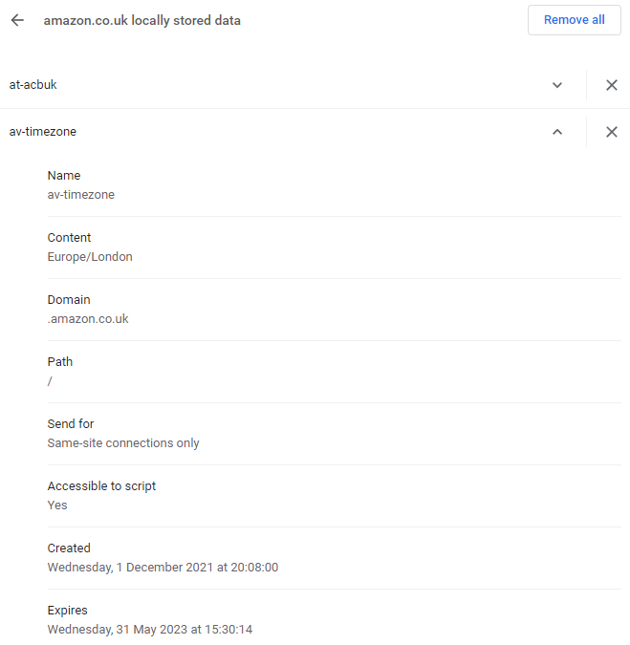
What is a cookie?
All modern browsers will allow you to view the contents of all cookies currently stored on your device and clear them if you wish.

Slide 6

Cookies
A cookie is a small text file with ID tags that is stored on your computer. Cookies are created when you use your browser to visit a website. They are used to track your movements on the website and can help by:
Resuming where you left off when you revisit the site.
Remembering your registered login.
Remembering theme selections.
Remembering preferences.
Customising your experience in other ways.
Session cookies
Created and replaced every time a user visits a website.
Persistent cookies
Created and saved on the first visit to a website.
Retained until they expire.

Slide 7


